Slide 1
Fake News Detection
Notes:
Is it working? Can you see?
Topic of investigation: Fake News Detection
Johan Horsmans
Brief overview of presentation

Slide 2
Presentation
Fake News Detection
Relevance
Scope
Data
Datasets
Preprocessing
Part 1: Classification
Methods
Results
Discussion
Part 2: Dynamic Word Embeddings
Methods
Results
Discussion
Conclusion
Questions and discussion
Notes:
Unfortunately, I won’t have time to go into much detail so:
Feel free to interrupt me if you have any questions.
Also, haven’t included references in the slides, nor particulars such as hyperparameters
Since its included in synopsis

Slide 3
Fake News Detection
Notes:
Relevance of topic
+
Scope of what we sought to investigate

Slide 4
Fake News Detection - Relevance
Notes:
Fake News
Common definition:
False or misleading information presented as news
Problematic, but let’s put that aside for now

Slide 5
Fake News Detection - Relevance
Negative impact of Fake News
Notes:
Fake News has a negative impact on the world
Influences public opinion and thus foreign and domestic policies
Wider audience more recently -> Internet, SoMe
US elections Donald Trump -> Covid-19 Micro-chips Bill Gates

Slide 6
Fake News Detection - Relevance
Negative impact of Fake News
Manual inspection of news is unfeasible
Notes:
Unfeasible to detect Fake News through manual inspection
Spread on the internet on a lot of different websites.

Slide 7
Fake News Detection - Relevance
Negative impact of Fake News
Manual inspection of news unfeasible
ML approaches show promising results
Notes:
Automatic approach is preferred -> Previous ML studies high classif.
A study by Ahmed et al., utilizing the same data that we’re using
92% accuracy, using TF-IDF for feature extraction and
Support-Vector-Machine with a Linear kernel
BUT!

Slide 8
Fake News Detection - Relevance
Negative impact of Fake News
Manual inspection of news unfeasible
ML approaches show promising results
BUT! Generalizability?
Across sources
Across time
Notes:
BUT! Generalizability?
Across sources (datasets, or websites or media platforms)
Across time
If Fake News data in studies are sampled from different sources, then the patterns that distinguishes the Fake News from the Real News, may not necessarily be the same. If this is the case, then the models would generalize quite poorly.
Other fields have these problems -> paper with Riccardo

Slide 9
Fake News Detection - Scope
Notes:
Scope

Slide 10

Fake News Detection - Scope
We wanted to investigate:
The potential lack of generalizability in the field.
Train and cross-test classification models between datasets
The non-staticity of news articles
Explore dynamic word embeddings across time
Notes:
With off-set in the previously mentioned point, the scope of our project was to:

Slide 11
Fake News Detection - Scope
We wanted to investigate:
The potential lack of generalizability in the field.
Train and cross-test classification models between datasets
The non-staticity of news articles
Explore dynamic word embeddings across time periods
Notes:
More specifically, we would do this by:

Slide 12
Fake News Detection - Scope
We wanted to investigate:
The potential lack of generalizability in the field.
Train and cross-test classification models between datasets
The non-staticity of news articles
Explore dynamic word embeddings across time periods
Notes:
This would allow us to make inferences the generalizability of models across:
Data from different sources
and
Data from different time periods

Slide 13
Data
Notes:
Now, short on the data, since it plays a fundamental role in project

Slide 14
Data - Datasets
Two datasets:
Dataset 1 (large)
Dataset 2 (small)
Notes:
Dataset 1:
Roughly 45000 entries
2015-2017
University of Victoria, lab: Information security and object technology
Ahmed et al., x 2
92% accuracy,
Dataset 2:
Roughly 300 entries
2016-2017
Horne et al., + Silverman et al.,

Slide 15
Data - Datasets
Two datasets:
Dataset 1 (large)
Dataset 2 (small)
Different sources of Fake News
Both used in previous research
Notes:
Different sources of Fake News (as stated in the synopsis)
Both used in previous ML research

Slide 16
Data - preprocessing

Slide 17
Data - Preprocessing
Dataset 1 (large):
Systematic patterns
Dataset 2 (small):
Satirical Fake News
Notes:
Systematic patterns:
[city name] Reuters
Surprisingly, given that the Victoria University institute commented on the data being preprocessed.
Satirical Fake News

Slide 18
Data - Preprocessing
Dataset 1 (large):
Systematic patterns
Dataset 2 (small):
Satirical Fake News
Tokenization, lowercasing, stopwords + special characters, lemmatization
Train-validation-test-splitting
Notes:
Systematic patterns:
[city name] Reuters
Surprisingly, given that the Victoria University institute commented on the data being preprocessed.
Satirical Fake News

Slide 19
Part 1: Classification

Slide 20
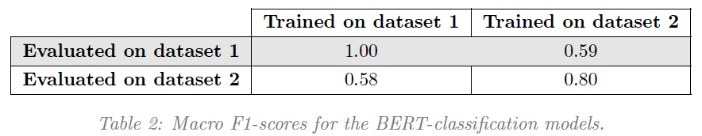
Part 1: Classification
Train/Val/Test
BERT Base Uncased -
Notes:
Bert Base Uncased (from HuggingFace)
See table:
Macro F1-score as performance metric -> feel free to ask if you want me to elaborate on this choice
Within dataset -> test partition.
Across datasets -> unpartitioned
Confounds
Large differences in Fake News articles, when compared to Real News

Slide 21
Part 1: Classification
What do these results suggest?
Poor generalizability
Confounding factors
Notes:
What do these results suggest?
Poor generalizability
= large drop in performance across datasets = model is overfitting to the specific dataset
Could it be due to poor methodological practice? Couldn’t we just have used early stopping?
We optimized performance for the validation set. These are the test-set performances.
Large dataset (dataset 1) F1-score = 1
Doesn’t necessarily undermine the finding of poor generalizability BUT it seems:
Alarmingly large differences across classes -> many abbreviations, misspellings, slang
Confounding factors:
Flagging procedures unspecified (Politifact)
Some articles not specifically Fake News, but rather unverified opinions (seen through subsequent manual inspection)

Slide 22
Part 2: Dynamic Word Embeddings
Notes:
Analysis 2:
More exploratory in nature
We hypothesized that the task of classifying articles was non-static.
To explore and showcase or illustrate this, we wanted to investigated word-embeddings over time

Slide 23
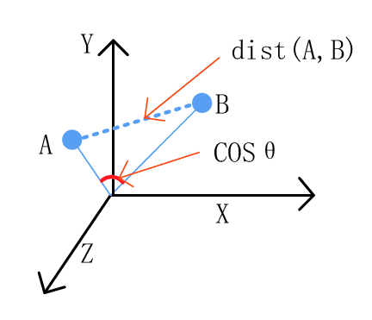
part 2: Dynamic Word Embeddings
Dataset 1 (large) -> Split into 5 periods
Trained fastText skipgram model on each period
word embedding for each word, for each period
Nouns with largest semantic shift
Found 10 nearest neighbours for words, across time periods
Notes:
Split data
Not just ordering by date, and splitting with equal number of entries in each period
Rather ordered by date, split by date
Trained fastText skipgram model on each period
Resulting in a vector representation for each word for each time period
Word embedding space (please ask)
Cosine distance (please ask)

Slide 24
part 2: Dynamic Word Embeddings
“Russia” Nearest neighbours:
1st 2nd 3rd
T1: Syria Putin Military
T2: Syria Region Assad
T3: Putin Vladimir NATO
T4: Connection Putin Intelligence
T5: Meddle Collude Putin
Notes:
Showcasing the differences in word meanings, here for the word Russia

Slide 25
part 2: Dynamic Word Embeddings
What do these findings suggest?
The non-staticity of the task influences generalizability across time periods
Notes:
Not concrete evidence -> Rather illustration of a point that seems forgotten in some research that we encountered
The task of detecting Fake News (and actually also real news) is non-static
The findings showcase the problem of how non-staticity interferes with building word-embedding representations that are reliable and generalizable across time periods.
NOTE:
We handpicked the most changing words (semantically that is), which means we should be cautious of reading too much into “Russia”s NN across periods
Clear motive and thus not scientifically rigorous; meant to prove a point.
BUT:
This analysis is only across 2 years. Longer time periods would likely result in larger effects.
All words embeddings likely change!

Slide 26
Conclusion

Slide 27
Conclusion
Our study suggests:
Low generalizability of models in the field(?)
The task is non-static
Data is important
We recommend:
Have data from different sources
Be aware of data quality (unrelated systematic patterns)
Continually update with newest data
Definition of Fake News

Slide 28
Questions?
Notes:
Distance metrics
Other distance metrics could have been utilized:
Cosine distance
Euclidean distance
Cosine distance and Euclidean distance are widely different
Use paper and draw (in advance): ??
-0.1,-0.1. vs. 0.1, 0.1
and
1000000000, 1000000000 vs. 1, 1
Which metric is best?
Different uses, BUT:
Perhaps Euclidean distance would have been better for this task.
Preprocessing
Tokenization
By whitespace
How did our method used handle “it’s”
????
Stopword removal?
Removal of frequent, but information-low words.
Reduces noise and lowers computational power needed.
Lemmatization?
Lemmatization -> Grouping together inflected forms of the same word, into the lemma
What is a lemma?
Semantic nucleus of a word
Infinitive for verbs
Singular form for nouns
How is lemmatization carried out?
Two methods:
Look-up table
Morphology based approach (word internal structure to predict lemma, requires trained model)
Which lemmatization method did we use?
?????
What other preprocessing steps could have been utilized?
Instead of lemmatization, we could have used stemming:
Similar to lemmatization, but simpler (and not necessarily humanly interpretable):
Argue, argued, argues, arguing, and argus - > stem = argu
Concept of word embeddings
?
fastText
?
BERT
?
What is Fake News?
We need a definition that is:
a) universally accepted -> much easier to conduct research as well as share and expand datasets this way
b) practically applicable -> steadfast rules for coding Fake News and Real News
Datasets?
Size impact:
Small dataset -> Worse learning, poor evaluation metrics (few samples, more inaccurate)
Quaility impact:
Poor generalizability for poor quality
Train/val/test
-

